Slide 1





















































TELEVISION
MVPD SET TOP BOX / TVE
BROADCAST
CABLE/SAT TELCO
240+
Affiliates
WEBSITE
MOBILE APPS
CONNECTED DEVICES IP Streaming, Game Console, Smart TV
SVOD
DIGITAL
AD SUPPORTED / FREE
SOCIAL MEDIA / PORTAL / OTHER
OTHER PLATFORMS
dMVPD

Slide 2
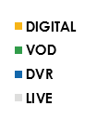
35-DAY TOTAL VIEWING
Live and traditional time-shifted viewing (DVR / VOD) has been declining, while digital viewing has increased
A18-49 ENTERTAINMENT AVERAGE SEASON TREND
% OF
DIGITAL CONTRIBUTION
12%
17%
19%
25%
NOTES
Despite changes in the method of viewing, ~95% of total viewing in each season is on the TV screen (vs. approx. 5% PC/Mobile)
75% of digital viewing in 18-19 was through OTT devices on the TV screen (vs. 25% PC/Mobile), vs. 60% OTT in 15-16
TV is the #1 “Can’t Live Without”
Notes:
31719 FILE
SLIDE 19
Is the table necessary? And do we need the % changes over each season? I think 18-19 could be enough or even – we could speak to it, since the bars are pretty straightforward in showing the patterns. Live viewing down -13% is two-tenths in the chart vs. digital up +33% and also two-tenths. Maybe % changes could just be distracting. -MM

Slide 3
Are your viewing habits changing?
yes
Also Yes, but in purple

Slide 4
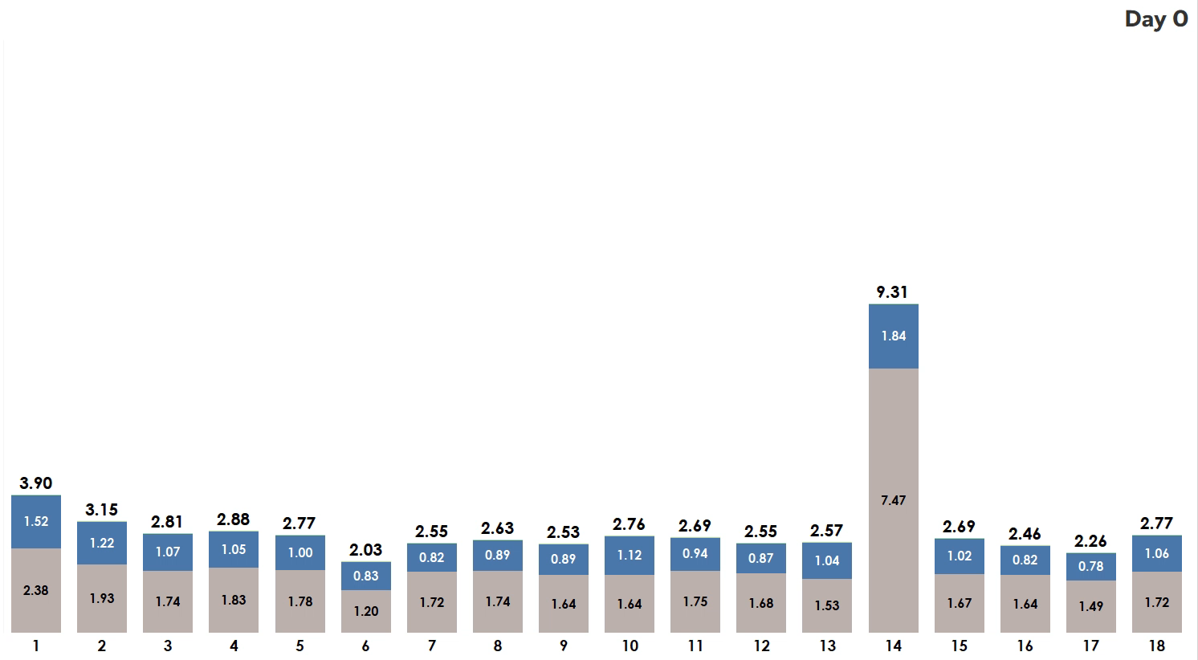
NBC DRAMA “X” LONGTAIL
A18-49 TOTAL AUDIENCE RATINGS BY EPISODE & DAY
Digital/STB VOD
DVR
Live

Slide 5
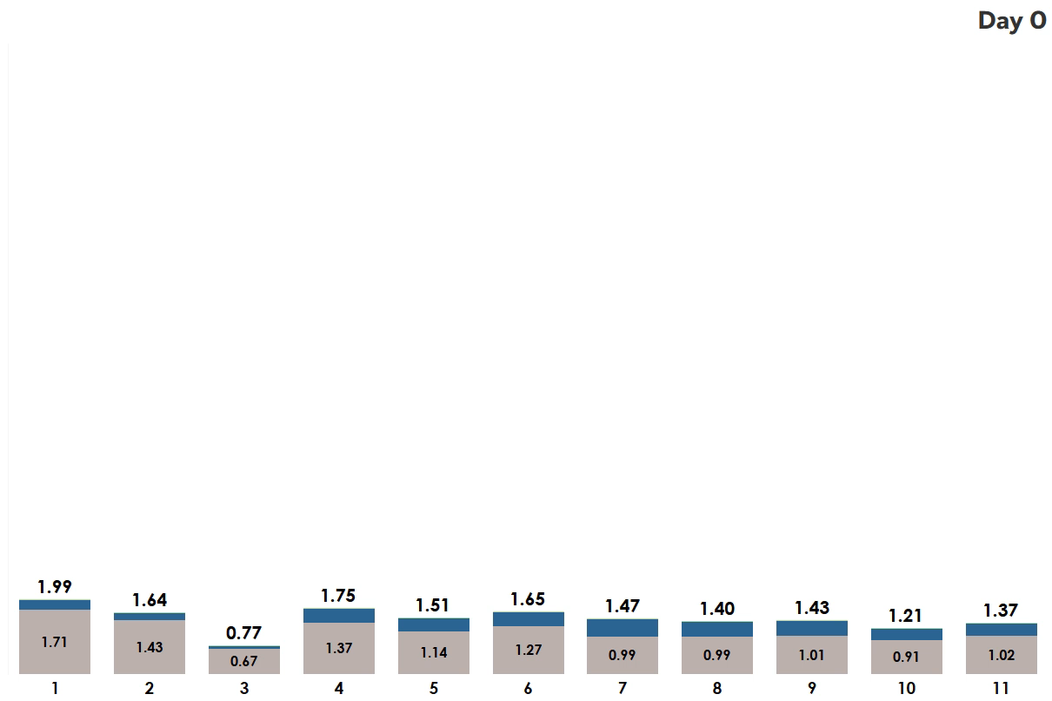
NBC COMEDY “Y” SEASON ONE LONGTAIL
A18-49 TOTAL AUDIENCE RATINGS BY EPISODE & DAY
Digital/STB VOD
DVR
Live

Slide 6
Comedy “Y” – 17/18 Season Viewing 2017/18 VIEWING PROFILE
All viewing to Comedy Y current season, on any platform, during the 17/18 broadcast Season
Season NBCD Breakdown
(2% of total 17/18 viewing)
Season Hulu Breakdown
(40% of total 17/18 viewing)
Source: Based on viewing during 17/18 season – 9/25/17-9/23/18

Slide 7
NBC Drama “X” – 17/18 Season 2 Viewing 2017/18 VIEWING PROFILE
All viewing to Drama X current season, on any platform, during the 17/18 broadcast Season
Season NBCD Breakdown
(3% of total 17/18 viewing)
Season Hulu Breakdown
(21% of total 17/18 viewing)
Source: Based on viewing during 17/18 season – 9/25/17-9/16/18 available dates.

Slide 8








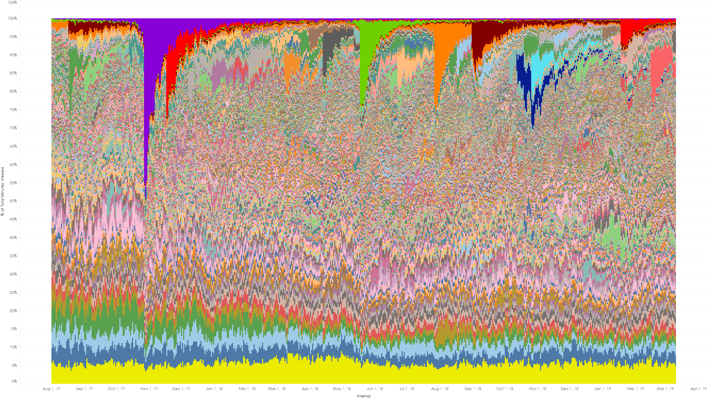











% of “SVOD PROGRAMS” time spent BY DATE
PURPOSE / PROCESS
% of total A18-49 minutes viewed by date across all measured series in SVOD Programs originator
Internal metadata process separates movies/specials from series
Quickly surfaces disruptors in the SVOD landscape, illustrates general consistency of acquired shows
INSIGHT
Stranger Things averaged 46% of total 18-49 SVOD series viewing during the S2 opening weekend
Feb 2019 daily avg: 0.2%
The Office averages 6% of total measured 18-49 TV screen viewing
Min: 3.3% / Max: 9.0%
The Office + Friends + Grey’s Anatomy average over 12% of daily A18-49 series viewing
8/1/17
9/1/17
10/1/17
11/1/17
12/1/17
1/1/18
2/1/18
3/1/18
4/1/18
5/1/18
6/1/18
7/1/18
8/1/18
9/1/18
10/1/18
11/1/18
12/1/18
1/1/19
2/1/19
3/1/19
Source: Nielsen SVOD Content Ratings, 8/1/17-3/10/19, P18-49 weighted tuning minutes by date, represented as % of total by date. Excludes movies and one-off specials as defined by NBC Research.

